Slide 1
Embracing Compassionate Leadership
Welcome
Practices for a connected workforce
platfformwellbeing.com

Slide 2
CLAIRE-MARIE HEANEY
ZOE JEFFERYS
EWAN HILTON
HEAD OF RELATIONAL
PRACTICE AT PLATFFORM
CLINICAL PSYCHOLOGIST IN TRAINING AT NHS WALES
CEO OF
PLATFFORM

Slide 3
Who are Platfform Wellbeing?
Workplace Wellbeing
Talking Therapies
Education Wellbeing
Supervision

Slide 4
Leading people; a compassionate and relational approach.
Zoe Jeffreys, Clinical Psychologist in Training.
@psychologistdoodles

Slide 5
What we hope to achieve today..
What is compassion?
Why should we apply this to leadership?
What are the benefits for us, and our organisations?
Why it starts with us?

Slide 6
What is compassion?

Slide 7
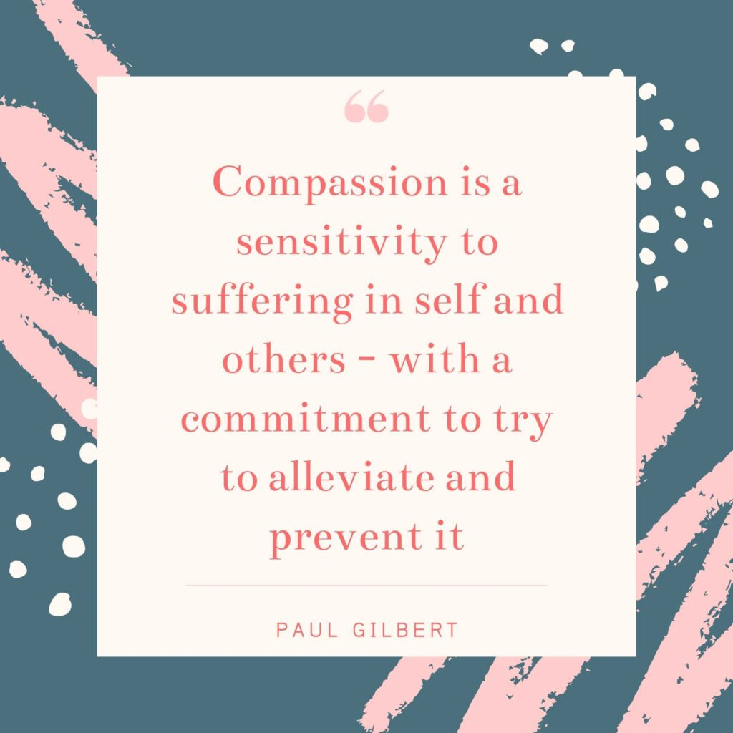

Slide 9
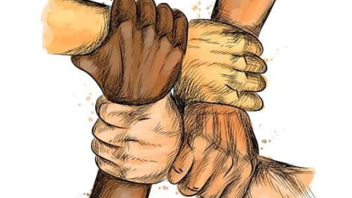

Slide 10
How does this apply to work?

Slide 13
Workplace stress
Loneliness

Slide 14
“We become mechanistic, lose our humanity, and that’s when we start hurting each other, hurting the planet … it can be a pretty dark place if you choose to go there.”
Loren Shuster, chief people officer and head of corporate affairs of the LEGO Group

Slide 15
Compassionate leadership

Slide 16
“Compassionate leadership can be conceived as a personality encompassing the traits and behaviours of compassionate love, care, selflessness, wisdom, integrity, empathy, accountability, authenticity, presence, dignity, self-compassion and self-cultivation as a matter of inducing, motivating, influencing, persuading people to achieve their personal and organisations growth”
(Ramachandran et al., 2023)

Slide 17
Jane Dutton (2014).

Slide 18
West (2021).

Slide 19
Compassionate Leadership (West, 2018) | “Imperfect” Leader (Munby, 2019) | Daring Leader (Brene Brown, 2018).
Authentic | Self-aware | Courageous
Transparent and open | Know their weaknesses | Leans into vulnerability
Curious | Empathetic | Lives to values
Shows humility | Lets go of ego | Self compassionate
Optimistic | Learners | Trustworthy
Appreciative | Not afraid to be imperfect | Open to emotions
 |  | Has boundaries
 |  | Accountable

Slide 20
Being together
Shared beliefs and values
Collective leadership
Inclusiveness/
diversity
Learning environment
Open to emotion
Communication
Trust
Patterns of reinforcement
Psychological safety
West (2020), Whitehead (2019), Hougaard & Carter (2022) and Papworth (2023).

Slide 22
Those who experience compassionate leadership report more affective commitment and talk more positively about their organisation (Lillus et al., 2008).
Compassionate leadership is more likely to generate system resilience in times of stress (Boyatzis et al 2013; Melwani et al., 2012).
Supervisors who perceive that their organisation values their well-being are more likely to show supportive behaviour towards people they manage (Eisenberger, 2006).
When compassion is core to organisational values, there is a measurable increase in productivity, financial performance and employee engagement and retention (Kim et al, 2011; Moon et al., 2016) .
Compassionate and safe environments allow us to experience positive emotions, which in turn lowers our blood pressure, strengthens our immune system and decreases psychological distress and inflammation (Fredrickson et al, 2000, 2013; Gross, 1994; Boyatzis et al., 2016).
Workplace benefits
Experiencing compassion at work connects co-workers' bonds at work and build understanding (reducing the impact of loneliness; Lutz et al; 2008 Frost et al, 2000). It also reduces ingroup bias (Seppala et al., 2013).
In care environments, compassionate organisations reduce the likelihood of burnout, better health outcomes for the people being cared for and support increased innovation (Fotaki, 2015; Lilius et al., 2011; West et al., 2017).

Slide 23
Your health and wellbeing

Slide 24
Why it starts with us?

Slide 25
https://www.brilliantlifecommunity.com/blog/understanding%20the%20window%20of%20tolerance

Slide 27
. . . what really counts is that in moments of pain and suffering someone stays with us. More important than any particular action or word of advice is the simple presence of someone who cares . . . In a time so filled with methods and techniques designed to change people, to influence their behaviour, and to make them do new things and think new thoughts, have lost the simple but difficult gift of being present to each other. We have lost this gift because we have been led to believe that presence must be useful . . . we have forgotten that it is often in ‘useless’, unpretentious, humble presence to each other that we feel consolation and comfort. Simply being with someone is difficult because it asks of us that we share in the other’s vulnerability, enter with him or her into the experience of weakness and powerlessness, become part of uncertainty, and give up control and self-determination. And still, whenever this happens, new strength and new hope is being born . . . For this reason, [those who sit with us] are the ones who bring new hope and help us discover new directions . . .
(Nouwen et al. 1983: 11–12).

Slide 28
References
Brown, B. (2018). Dare to lead. Random house publishing group.
Crego, A., Yela, J. R., Riesco-Matías, P., Gómez-Martínez, M. Á., & Vicente-Arruebarrena, A. (2022). The benefits of self-compassion in mental health professionals: A systematic review of empirical research. Psychology Research and Behavior Management, 2599-2620.
D'Oliveira, T. C., & Persico, L. (2023). Workplace isolation, loneliness and wellbeing at work: The mediating role of task interdependence and supportive behaviours. Applied Ergonomics, 106, 103894.
Dutton, J. E., Workman, K. M., & Hardin, A. E. (2014). Compassion at work. Annu. Rev. Organ. Psychol. Organ. Behav., 1(1), 277-304.
Francis, R. (2013). Report of the Mid Staffordshire NHS Foundation Trust public inquiry: executive summary (Vol. 947). The Stationery Office.
Gilbert, P. (2014). The origins and nature of compassion focused therapy. British journal of clinical psychology, 53(1), 6-41.
Hougaard, R., & Carter, J. (2022) Compassionate Leadership. Harvard Business.
Leka, S., Jain, A., & World Health Organization. (2010). Health impact of psychosocial hazards at work: an overview. iris.who.int/bitstream/handle/10665/44428/?sequence=1
Lieberman, M. D. (2013). Social: Why our brains are wired to connect. OUP Oxford.
Martino, J., Pegg, J., & Frates, E. P. (2017). The connection prescription: using the power of social interactions and the deep desire for connectedness to empower health and wellness. American journal of lifestyle medicine, 11(6), 466-475.
Meechan, Fiona. (2018). Compassion at Work Toolkit. (PDF) Compassion at Work Toolkit (researchgate.net)
Munby, S. (2019). Imperfect leadership: A book for leaders who know they don't know it all. Crown House Publishing Ltd.
Noushad, S., Ahmed, S., Ansari, B., Mustafa, U. H., Saleem, Y., & Hazrat, H. (2021). Physiological biomarkers of chronic stress: A systematic review. International journal of health sciences, 15(5), 46.
Ozcelik, H., & Barsade, S. G. (2018). No employee an island: Workplace loneliness and job performance. Academy of Management Journal, 61(6), 2343-2366.
Papworth, K. D. (2023). Compassionate Leadership: For Individual and Organisational Change. De Gruyter.
Ramachandran, S., Balasubramanian, S., James, W. F., & Al Masaeid, T. (2023). Whither compassionate leadership? A systematic review. Management Review Quarterly, 1-85.
Tietsort, C. J. (2021). Compassionate leadership at work: Cultivating compassion by reducing uncertainty, emphasizing personal well-being, and aligning compassionate actions (Doctoral dissertation, Arizona State University).
West, M. A. (2021). Compassionate Leadership. The Swirling Leaf Press.
West, M., & Bailey, S. (2022). What is compassionate leadership. What Is Compassionate Leadership? | The King's Fund (kingsfund.org.uk).
Whitehead, C. (2019). Compassionate Leadership: Creating Places of Belonging. Solopreneur Publishing.

Slide 29
Rethinking mental health: CPD accredited
Upcoming training
With Dr Sian Edwards
Explore our understanding of mental health
Understand relational working and its workplace benefits
Share and understand our experience of good leadership
Identify relationally healthy practices
Understand the impact of blame and shame
Provide tips on how to support our own mental health and those of our colleagues
Facilitate reflective practice
Cardiff sessions:
Wednesday 29th May
Thursday 27th June
Online sessions:
Wednesday 8th May
Friday 14th June
BOOK NOW

Slide 30
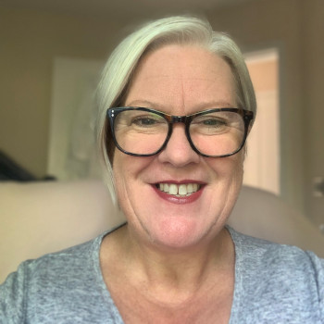
Get in touch
Mary Rogers
Business Development Manager
E: maryrogers@platfform.org
T: 07825 740285

Slide 31
We would love to hear your feedback
Please can you spare 2 minutes to complete our webinar survey following this link: https://forms.office.com/e/pEkXRCJ5EB

Slide 32
Thank you for joining us.
PLATFFORM WELLBEING
Expert Training.
Compassionate Workplaces.
Thriving Teams.
platfformwellbeing.com

